Slide 1

BRAND PROFILE & WEBSITE GUIDE

Slide 2
THE BRAND
Elite:- State of the Art; Lavish Facilities; Exclusive Admissions
Oxford Curriculum:- World, Class Well-being, Sustainability, Global Skills
Academic Powerhouse:-Rigorous Academics; Exceptional Faculty; cutting edge resources;
A Well-Rounded, Self-Aware, Thoughtful, Creative, Critical and Ethical Global Leader positioned to live a Meaningful and Fulfilling life and perform competitively in an Everchanging World.

Slide 3
ABOUT US
Nestled in the heart of the picturesque Borrowdale valley, in Crowhill, The Hill Preparatory is more than just a school, but a transformative journey that unlocks the full potential of every student. Established in 2024, this elite institution is redefining the boundaries of education by seamlessly blending renowned academic prowess with the cultivation of well-rounded, globally-minded leaders.
At The Hill, our curriculum goes far beyond the traditional focus on math, science, and English. Here, students embark on a holistic exploration of the world, developing essential life skills like critical thinking, creativity, ethical decision-making, and environmental stewardship. Through immersive global projects and cutting-edge technology, students learn to navigate an ever-changing landscape, emerging as confident, self-aware individuals poised to make a meaningful impact across the globe, all the while enjoying the dream of learning as per our motto “frui somnium doctrina.”
Within the school's state of the art facilities, exceptional faculty members with vast experience and proven academic record guide each child on a personalized path of growth and discovery. From the nurturing early years to the rigorous academic challenges of primary school, The Hill’s unwavering commitment to excellence ensures that every student reaches new heights of achievement first in Academics and then holistically in learning how to take care of one’s mind, personal relationship, physical self and the world around them.
This offering is then complemented by a pursuit of athletic excellence where world-class coaching staff provide students with unparalleled opportunities to hone their physical skills.
The School’s exclusive admissions process attracts families who share the institution's vision – to cultivate a diverse, collaborative community of thinkers, innovators, and global citizen. This elite haven, nestled amidst the natural splendour of Borrowdale, is where the global leaders of tomorrow are forged, empowered to conquer the world and lead lives of purpose and fulfilment.

Slide 4
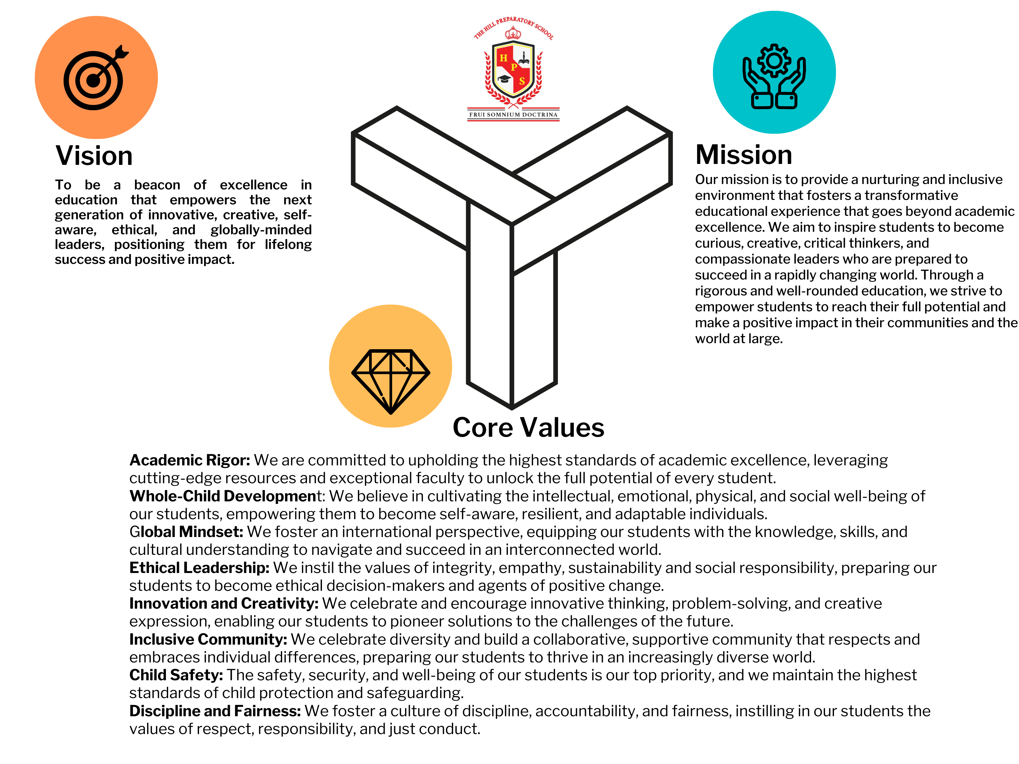

Slide 5
ACADEMICS
INFANT DEPARTMENT
JUNIOR DEPARTMENT
Infant Department: Laying the Foundation for Early Learning
The Hill’s Infant Department, comprising the Preschool (Nursery, ECD A, and ECD B), offers a dynamic and nurturing environment for our youngest learners.
The Early Childhood Development (ECD) program is designed to provide a safe and adventurous setting where children can thrive through play-based learning. This approach allows our pupils to enjoy the process of discovery while fostering their confidence and curiosity.
A key focus of the ECD curriculum is the development of gross and fine motor coordination, as well as pre-writing skills. These foundational abilities form the building blocks for future academic success and overall physical development.
To support the holistic growth of our infant learners, The Hill’s Infant Department welcomes specialist teachers for subjects such as Music, Computing, and Physical Education. These dedicated professionals collaborate with the classroom teachers to deliver a well-rounded educational experience.
Through this integrated approach, the Infant Department lays the groundwork for our students' academic and personal journeys, ensuring they are well-equipped to transition into the next stages of their educational development.
Our Academic program for our juniors focuses on a comprehensive approach to academia. Students in grades 1-7 will engage in a well-rounded academic program that goes beyond traditional subject-based learning. The program is structured to provide students with a solid foundation in core academic areas while also fostering the development of critical, creative, and global thinking skills.
In the early elementary grades (1-3), the focus will be on building a strong base in subjects like English, Mathematics, and Science. Students will develop fundamental skills in reading, writing, numeracy, and scientific inquiry through engaging, hands-on learning experiences.
As students progress to the upper elementary grades (4-6), the academic program will start to integrate more interdisciplinary and project-based learning opportunities. In addition to the core subjects, students will participate in Global Skills Projects, which combine multiple disciplines to address real-world challenges. This approach helps students develop problem-solving, collaboration, and communication skills.
Throughout the junior department (grades 1-7), the academic program also places a strong emphasis on Wellbeing. Students will learn about and practice healthy habits for their physical, mental, and emotional well-being. This focus on holistic development aims to support students' overall growth and success, both inside and outside the classroom.
The Hill’s academic program also incorporates the use of technology, with a dedicated Computing subject that teaches students essential digital literacy and coding skills. This prepares students to navigate and thrive in the increasingly technology-driven world.

Slide 6
SPORTS DEPARTMENT
SPORTS ON OFFER
Our aim is to encourage participation in all sport by all our children. It is our belief that involvement outside the classroom is very important in the overall development of individuals and facilitates the growth of an improved sense of self in each participant. We also recognise that sport plays an important role in the development of both physique and character.
TABS
Athletics
Cross-Country
Hockey
Soccer
Swimming
Tennis
Basketball
Golf
Netball
Volleyball
Our Teams
Our Results & League Tables
Sports News
Sports Houses & Mascot

Slide 7
ARTS & CULTURE
MUSIC & THEATRE DEPARTMENT
ARTS & CRAFT DEPARTMENT
The Music Education program provides students from Grade 0 to Grade 7 with a comprehensive and engaging curriculum. All classes at these grade levels have two music lessons per week, allowing students to develop a strong foundation in music literacy, theory, and performance.
Throughout this program, students will learn the basic principles of music literacy, including:
Music Theory: Students will gain a thorough understanding of musical elements such as pitch, rhythm, harmony, and musical form.
Rhythmic Reading and Writing: Students will develop the ability to read, write, and perform various rhythmic patterns and notation.
Sight Reading: Students will practice sight reading skills, enabling them to read and interpret different music notations with fluency.
Body Percussion: Students will explore the use of the body as a percussion instrument, enhancing their sense of rhythm and musicality.
The curriculum draws inspiration from the syllabi and resources provided by the Associated Board of the Royal Schools of Music (ABRSM), the Global Music Academy, and the new Zimsec Visual Arts and Performing Arts syllabus. This ensures that The Hill’s music education program aligns with internationally recognized standards and best practices, empowering students to develop well-rounded musical abilities.
By immersing students in this comprehensive music education program, The Hill aims to nurture their artistic expression, critical thinking, and collaborative skills – all of which are essential for their holistic development and future success.
Departmental Activities
School Choir ; Music Club; Drama Club; Instrument Lessons (piano, guitar, recorder, percussion and marimba).
The Arts and Crafts Program offers a diverse range of creative outlets for students, allowing them to explore their artistic talents and express their unique perspectives. The program is designed to nurture the students' artistic abilities, foster their problem-solving skills, and develop their appreciation for various forms of artistic expression. The Program at has the following offerings:
Visual Arts:- Drawing, Painting and Printmaking.
Crafts and Design:- Textiles and Fiber Arts.
Digital Arts and Media:-Graphic Design.
Through these diverse offerings, The Hill’s Arts and Crafts Program encourages students to explore their creativity, develop technical skills, and cultivate a deeper appreciation for the arts. By engaging in hands-on projects and collaborative learning experiences, students will not only hone their artistic abilities but also enhance their problem-solving, critical thinking, and communication skills – all of which are essential for their academic and personal growth.

Slide 8
ARTS & CULTURE (continued)
ICT
CLUBS & SOCIETIES
In a world driven by technology, computing has become an essential part of the educational experience, recognized as a new "literacy" alongside reading, writing, and numeracy. The Hill's computing curriculum is designed to equip students, aged 5 to 14 years, with the necessary skills and knowledge to thrive in the digital landscape.
The curriculum, based on the Oxford computing modules, aims to introduce students to the key ITC Skills they need to acquire computer literacy and understand the impact of technology on their daily lives. Through a comprehensive and engaging program, learners will develop proficiency in a range of applications, including:
Computer Programming Word Processing Digital Graphics Databases Spreadsheets Email and Presentations Video and Animation Digital security and e-safety.
At The Hill we believe that a well-rounded education extends beyond the classroom. To this end, we offer a diverse range of extracurricular opportunities that foster personal growth, leadership skills, and community engagement.
Our flagship programs include affiliation with the Lions International Cubs, Girl Guides, and Scouts organizations. These renowned youth development programs encourage service-learning, outdoor exploration, and practical life skills.
Beyond these established programs, The Hill hosts a wide array of student-led clubs and societies catering to diverse interests, from coding and robotics to art and music.
Through these vibrant extracurricular offerings, The Hill nurtures well-rounded individuals who can thrive both academically and personally. By fostering leadership, teamwork, and a sense of community, we empower our students to become engaged, confident, and socially responsible citizens, prepared to make a positive impact on the world.

Slide 9
OUR FACULTY
HEADMASTER
DEPARTMENTAL HEADS
Mr. Hans Christen, Headmaster
Mr Christen has taught at Ruzawi School, in Marondera, at Broadhurst Primary School in Gaborone and at Peterhouse Girls’ School. He is an ex-member of the Executive Committee of the Board of Governors of the Peterhouse Group of Schools, and a former headmaster of Twin Rivers School. Mr Christen holds a Bachelor of Arts degree from Rhodes University.
Head of Infants
Head of Arts & Culture
Sports Director

Slide 10
GENERAL WEBSITE TABS
School Calendar
News
Admissions
Contact Us
Social Media Links
Accreditations and Affiliations Logos
Our Library

